Slide 1
The raintrees kindergarten difference
Caring | Exploring | Fun
Rain Trees Kindergarten provides a caring, fun and friendly home-from-home environment for children between 2 and 6 years to learn through play.
Our Kindergarten is based on UK national curriculum and taught by qualified international and award winning teachers with extensive experience of providing education to expatriate communities since 1999.
Rain Trees Kindergarten is conveniently located in in a spacious detached property on Kheam Hock Road, between Adam Road and Stevens Road.
We are lucky to have a large and safe garden area. The school retains a small and friendly feel and has a maximum capacity for 80 children.
The spacious grounds of our Kheam Hock Rd campus..
Join us for a tour of the school and meet our highly qualified international and award winning teachers.
Rain trees kindergarten
60 Kheam Hock Road, Singapore, 298824
+65 64746181 | admin@raintreeskindergarten.com www.raintreeskindergarten.com

Slide 2
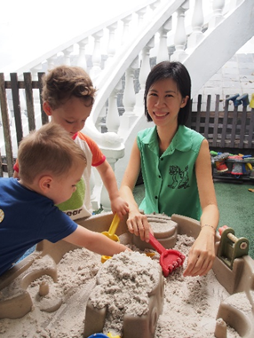
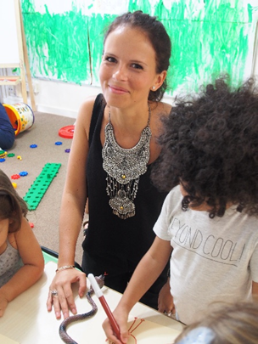
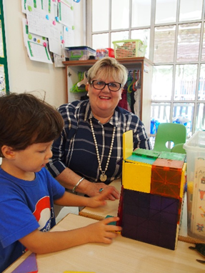
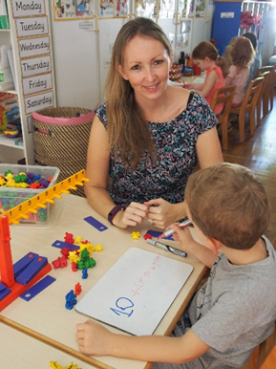
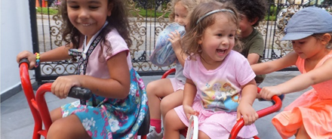
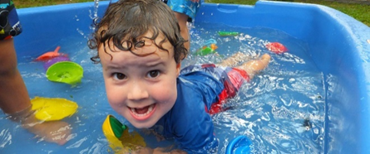
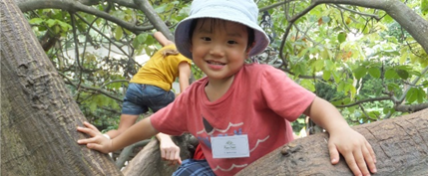
Why we love rain trees
Communication with our parents is vital. We listen to what they say:
OUR STAFF
Our parents agree that the most impressive thing about Rain Trees Kindergarten is the skills, attitude and dedication of the staff. Nearly 100% of parents believe the teachers have fantastic capabilities and we live up to our ethos of caring, exploring & fun. We are proud to have such highly trained international and award winning teachers on our staff.
THE CHILDREN ARE HAPPY!
The happy and caring environment, community feel and parental involvement in the school foster an happy and nurturing atmosphere. We believe we have created a warm, inviting and well-equipped environment where your child can play happily and learn at his or her own pace. This happy environment is a leading reason why our parents are so impressed with Rain Trees.
Rain trees kindergarten
60 Kheam Hock Road, Singapore, 298824
+65 64746181 | admin@raintreeskindergarten.com www.raintreeskindergarten.com
Source: 2016 Parents Survey

Slide 3
2016 testimonials
Our children have had an excellent experience at Rain Trees, the warmth of all the staff has made it feel like a second home. Our daughter has thrived here and I feel the foundations have been set for a love of learning which will stay with her. It's a small school but it's bursting with positivity.
My son attended has attended RainTrees for two years and we couldn't be any happier with a preschool! He immediately felt right at home in the warm cheery environment and with the friendly and superb teaching staff. My son has learned so much academically and socially through all the fun activities that the teachers plan. He loves his school so much that he is sad when he is ill or has to be picked up early and has even asked his teachers to move back to the U.S. with us and be his teachers there! We loved our time at RainTrees and would have gladly sent my younger daughter as soon as she turned two if we weren't leaving SG. Their new school will definitely have big shoes to fill after such a wonderful experience at RainTrees!
Naomi and Phillip Clarke, parents of Grace and Theodore (country)
Our Son has really enjoyed his time at Raintrees. His command on the English language has also developed significantly.
Munenari and Machiko Nomura, parents of Masanari and Hisanari (Japanese)
We couldn't have been luckier in choosing this school for our twin boys. They settled in from the moment they walked into the classroom!
Carrie and Ross Leedy, parents of Charles (American)
Gill and Jim Burns, parents of Angus and Robert (British)
Rain trees kindergarten
60 Kheam Hock Road, Singapore, 298824
+65 64746181 | admin@raintreeskindergarten.com www.raintreeskindergarten.com
Source: 2016 Parents Survey

Slide 4
Caring | exploring | fun
I would definitely recommend you (and do) as I think you create a very nurturing environment for children to flourish.
We are extremely happy with Raintrees and our Son loves it. We feel lucky that we have been able to find a place that nurtures each child as an individual and helps our Son to thrive.
Colin and Joanna Moss, parents of Arlo
(British)
Zowie and Scott Woollard, parents of Samuel
(country)
In his own words, "My school is amazing".
Jennifer and Morne Erasmus, parents of Timo
(American/South African)
Our parents (98%) have overwhelmingly recommended Rain Trees to their friends and colleagues
I recommend it all the time!
I have on many occasion
Carrie and Ross Leedy, parents of Charles (American)
Lesley and Peter Crawshaw, parents of Lilly
(New Zealand)
Rain trees kindergarten
60 Kheam Hock Road, Singapore, 298824
+65 64746181 | admin@raintreeskindergarten.com www.raintreeskindergarten.com
Source: 2016 Parents Survey

Slide 5
Diverse international student body
Rain trees kindergarten
60 Kheam Hock Road, Singapore, 298824
+65 64746181 | admin@raintreeskindergarten.com www.raintreeskindergarten.com

